Slide 1
Wait to Be Done
Need to Be Revised
Step 1: Land Application Unit;
Generic Soil Column Module
(EPA model)
Step 3: Refine Pharmacokinetic Model
Biosolids
Soil
Plant
Animal
Human
corn, grass, etc.
swine, cattle etc.
Step 2: Diet Composition and Bioaccumulation Literature Review
Step 4: Estimate Daily Intake
Notes:
https://doi.org/10.1016/j.fct.2023.114062

Slide 2
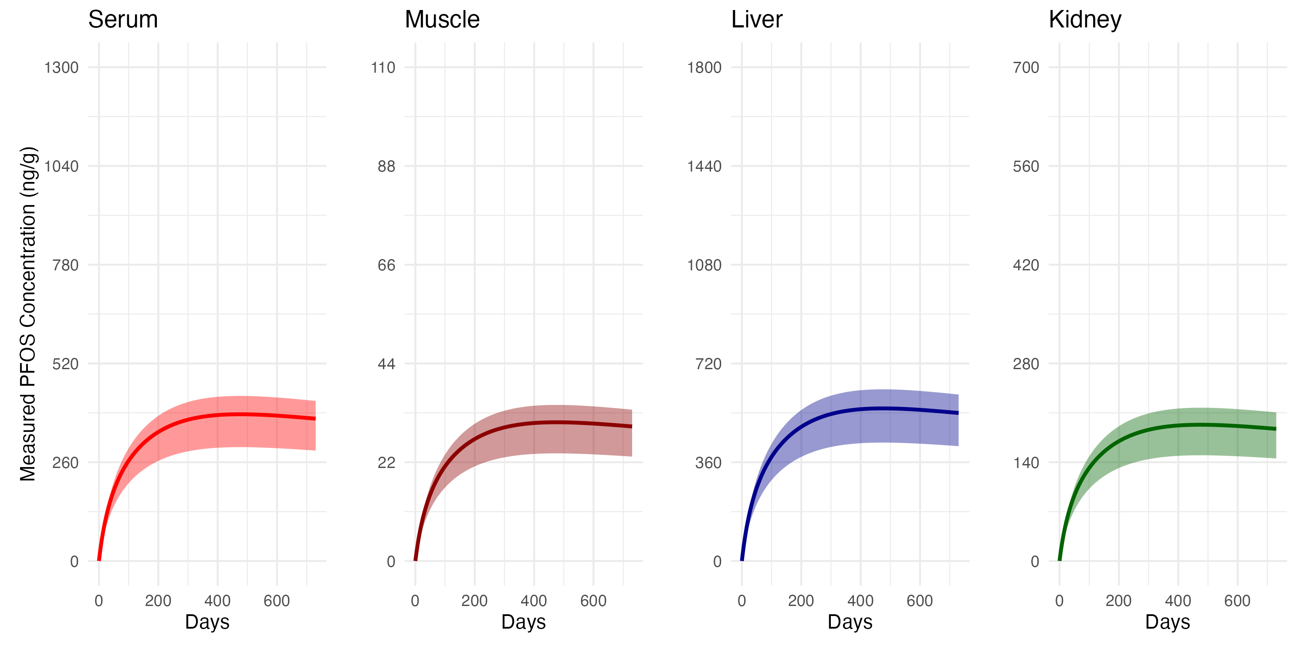
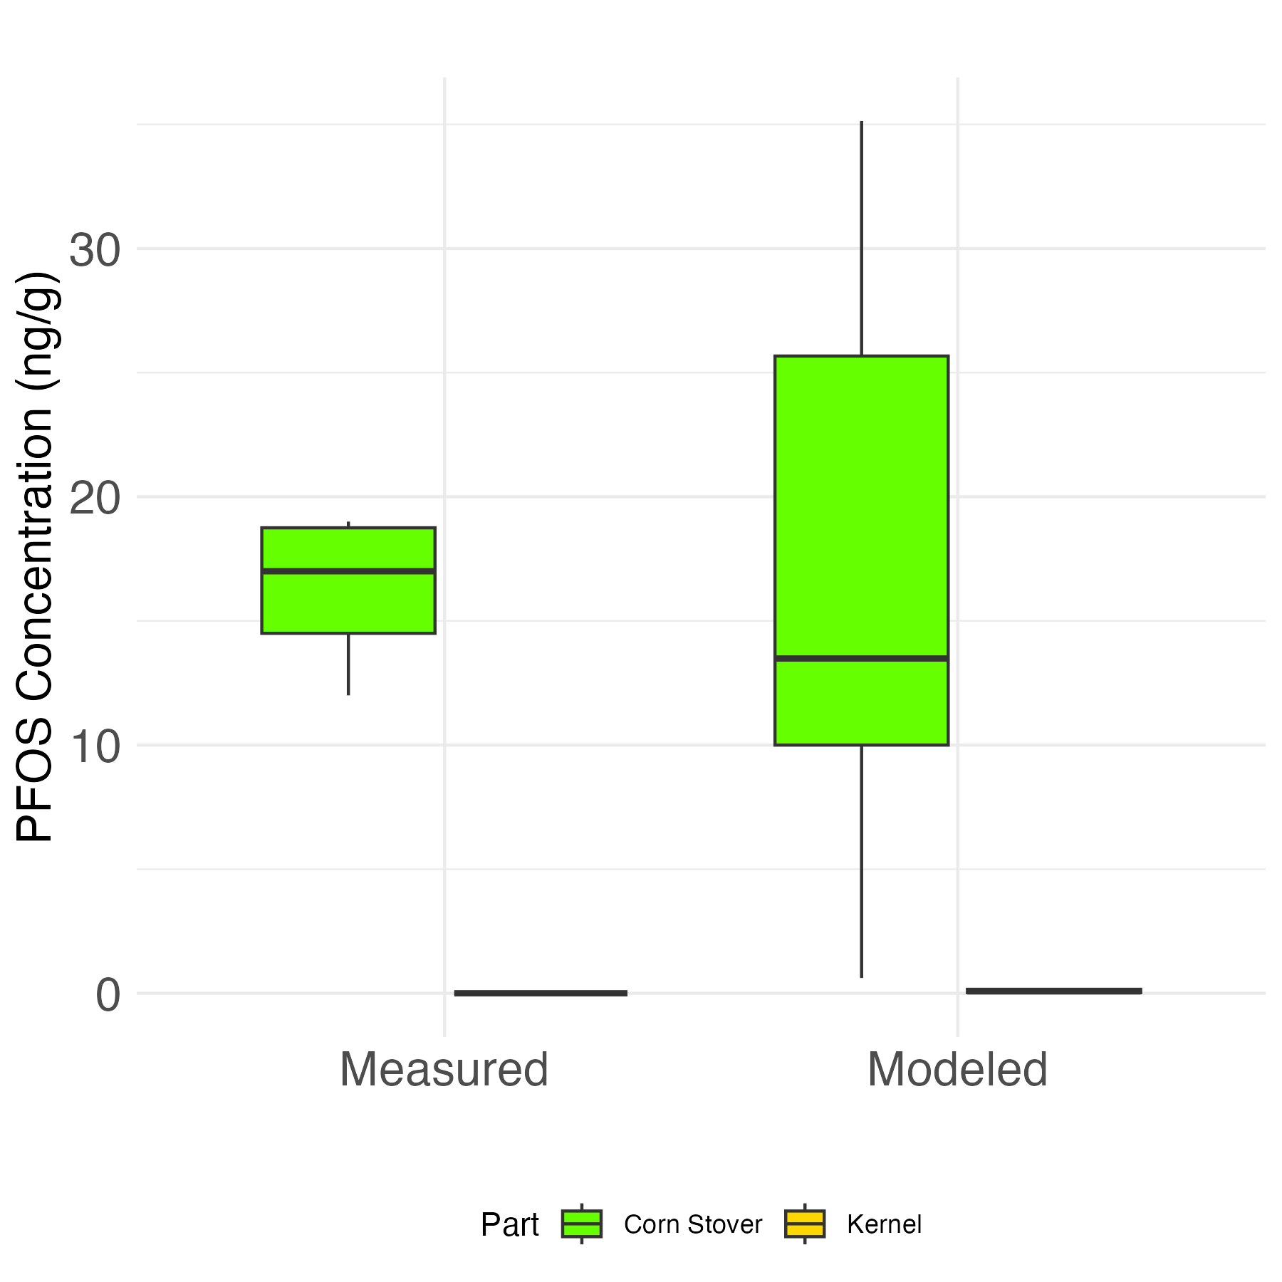
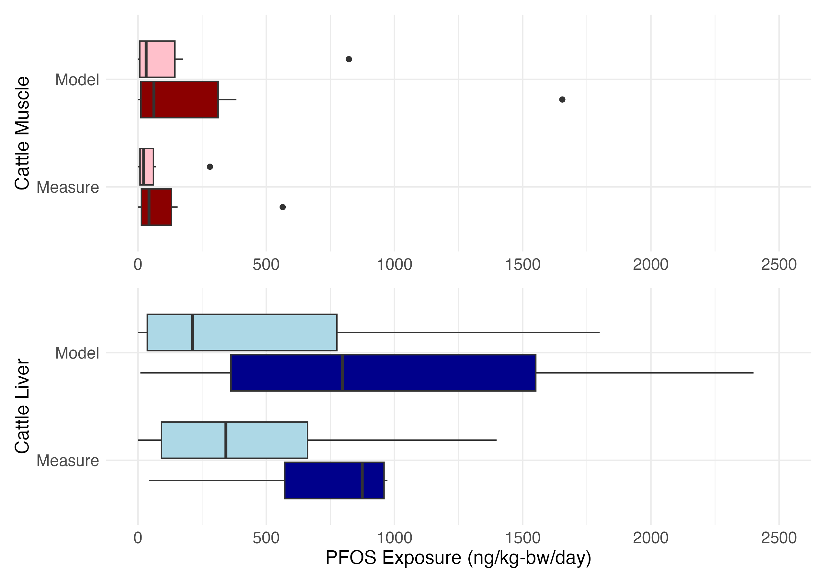
Input
Default parameters can be revised
Output
Dataset (csv file), Interactive dashboard
Biosolids
concentration
frequency
……
Animal
breed
diet composition
matter intake
soil intake
water intake
……
Animal compartment concentrations
Plant
Plant concentration
bioaccumulation factors
frequency
……
Human
age group
gender
consumption rate
……
Human Exposure Assessment

